Slide 1
Introduction to Data Science

Slide 2
Data Data Data….
“Data is the new oil” - Clive Humby declared in 2006
Data growth in both commercial and scientific databases due to advances in data generation and collection technologies
Lots of data is being collected and warehoused

Slide 3
Big Data
3Vs
Volume
The size of the data
Variety
The diversity of sources, formats, quality, structures
Velocity
The latency of data processing relative to the growing demand for interactivity
Veracity
Value
5th Vs
4th Vs

Slide 4
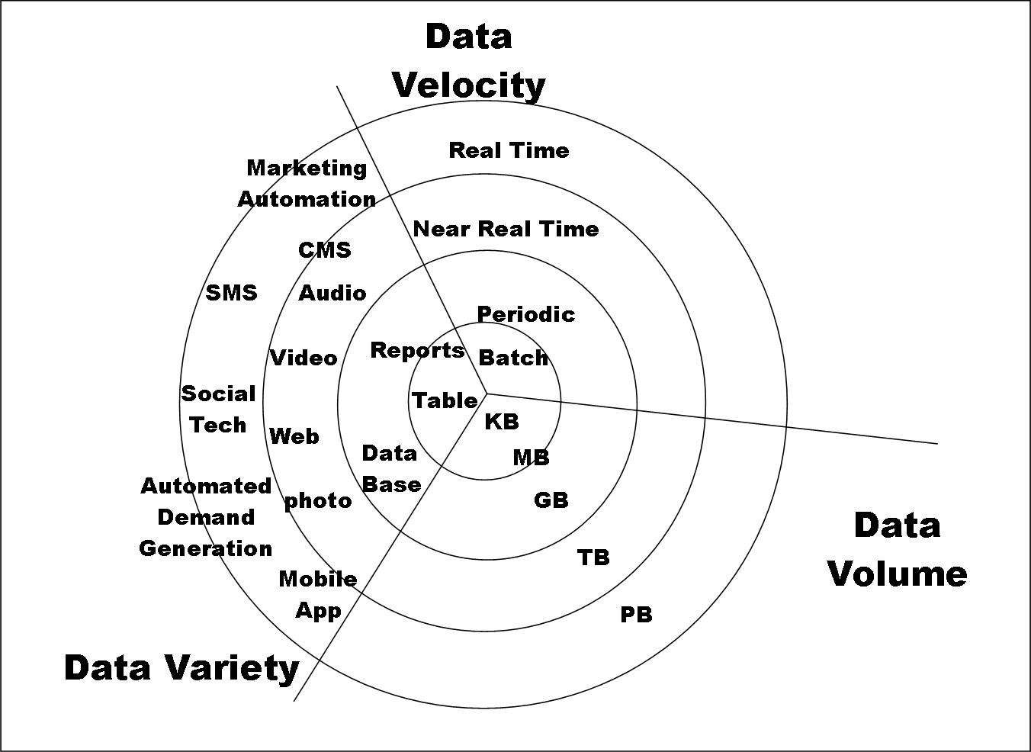
Big Data

Slide 5
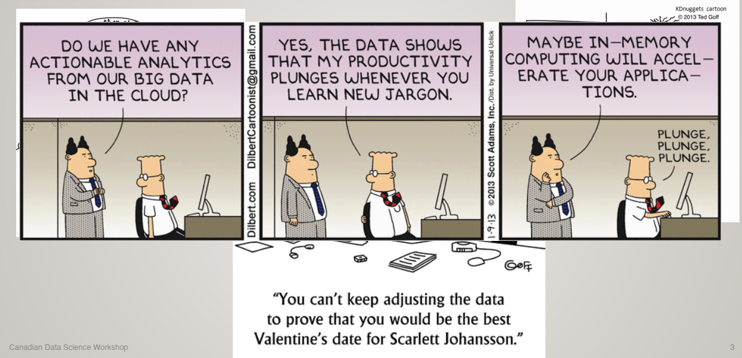
Data (contd…)
Source: ÖZSU et al., PPT: “DATA SCIENCE ECOSYSTEM”

Slide 6
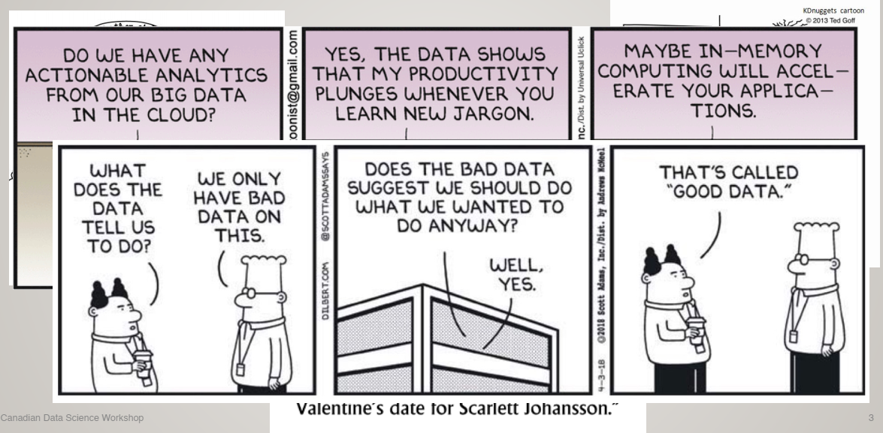
Big Data (contd…)
Source: ÖZSU et al., PPT: “DATA SCIENCE ECOSYSTEM”

Slide 7
What To Do With These Data?
Aggregation and Statistics
Data warehousing and OLAP
Indexing, Searching, and Querying
Keyword based search
Pattern matching (XML/RDF)
Knowledge discovery
Data Mining
Statistical Modeling

Slide 8
Big Data and Data Science
“… the sexy job in the next 10 years will be statisticians,” Hal Varian, Google Chief Economist
The U.S. will need 140,000-190,000 predictive analysts and 1.5 million managers/analysts by 2018. McKinsey Global Institute’s June 2011
New Data Science institutes being created or repurposed – NYU, Columbia, Washington, UCB,...
New degree programs, courses, boot-camps:
e.g., at Berkeley: Stats, I-School, CS, Astronomy…
One proposal (elsewhere) for an MS in “Big Data Science”

Slide 9
What is Data Science?
“Data science, also known as data-driven science, is an interdisciplinary field of scientific methods, processes, algorithms and systems to extract knowledge or insights from data in various forms, either structured or unstructured, similar to data mining.” -Wikipedia
An area that
manages,
manipulates,
extracts, and
interprets knowledge from tremendous amount of data
Data science principles apply to all data – big and small

Slide 10
What is Data Science?
Fourth paradigm
“… change of all sciences moving from observational, to theoretical, to computational and now to the 4th Paradigm – Data-Intensive Scientific Discovery”

Slide 11
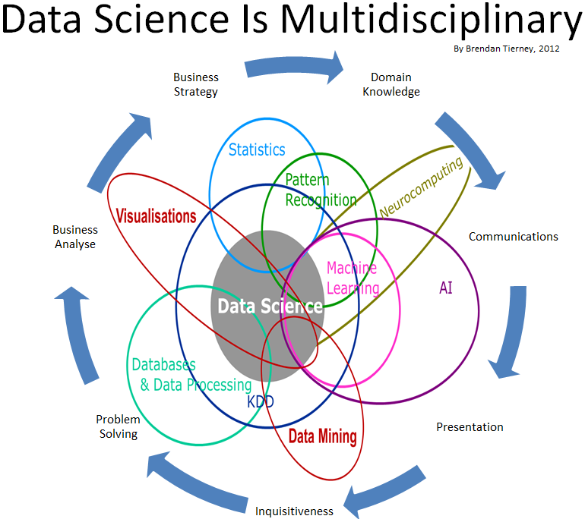

Slide 12
What is Data Science?
Theories and techniques from many fields and disciplines are used to investigate and analyze a large amount of data to help decision makers in many industries such as science, engineering, economics, politics, finance, and education
Computer Science
Pattern recognition, visualization, data warehousing, High performance computing, Databases, AI
Mathematics
Mathematical Modeling
Statistics
Statistical and Stochastic modeling, Probability.

Slide 13
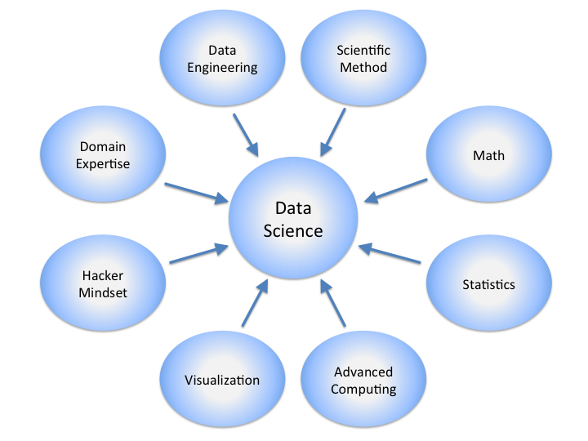

Slide 14
Real Life Examples
Companies learn your secrets, shopping patterns, and preferences
For example, can we know if a woman is pregnant, even if she doesn’t want us to know? Target case study
Data Science and election (2008, 2012)
1 million people installed the Obama Facebook app that gave access to info on “friends”

Slide 15
Data Science and Big Data – SAME?
NO
Big data = crude oil
Data science is about refining the “crude oil”

Slide 16
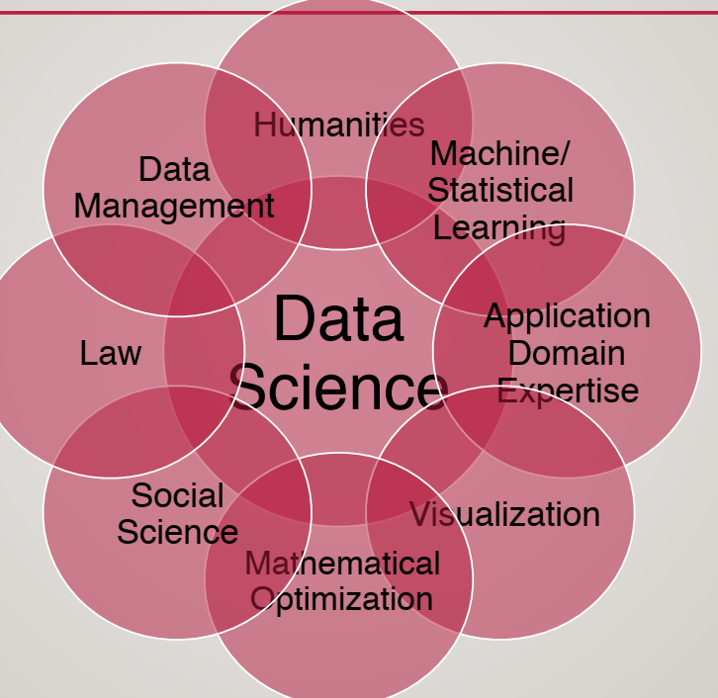
Data Science
Data Science depends upon DATA and Application.

Slide 17
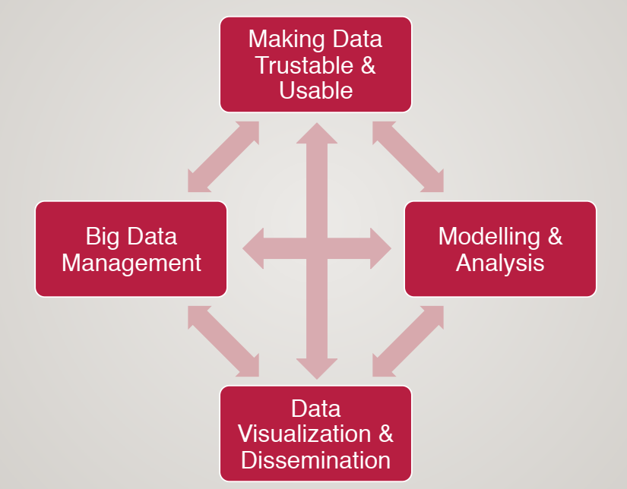
Core Research Issues & Interactions

Slide 18
Sources
ÖZSU et al., on “Data Science Ecosystem”
Nasr et al. “Introduction to Data Science”
https://hbr.org/2012/10/data-scientist-the-sexiest-job-of-the-21st-century/

